Slide 1
UNIT-V
SQLite database

Slide 2
(MR20-1CS0116) Mobile Application Development
UNIT – I Introduction to Android Operating System:
Android OS and Features – Android development framework; Installing and running applications on Android Studio, Creating AVDs, Types of Android application; Creating Activities, Activity Life Cycle, Activity states, monitoring state changes
UNIT – II Android application components :
Android Manifest file, Externalizing recourses like Simple Values, Drawables, Layouts, Menus, etc. Building User Interfaces: Fundamental Android UI design, Layouts – Linear, Relative, Grid and Table Layouts. User Interface (UI) Components
UNIT – III Fragments :
Creating fragments, Lifecycle of fragments, Fragment states, Adding fragments to Activity, adding, removing and replacing fragments with fragment transactions, interfacing between fragments and Activities,
UNIT – IV Intents and Broadcasts:
Using intents to launch Activities, Types of Intents, Passing data to Intents, Getting results from Activities, Broadcast Receivers – Using Intent filters to service implicit Intents, Resolving Intent filters
UNIT – V Database:
Introduction to SQLite database, creating and opening a database, creating tables, inserting retrieving and deleting data;

Slide 3
Syllabus
Introduction to SQLite database
Creating and opening a database
Creating tables
Inserting retrieving and deleting data

Slide 4
Introduction to SQLite database
SQLite is an open-source relational database i.e. used to perform database operations on android devices such as storing, manipulating or retrieving persistent data from the database.
It is embedded in android by default. So, there is no need to perform any database setup or administration task.
SQLite supports all the relational database features. In order to access this database, you don't need to establish any kind of connections for it like JDBC,ODBC etc.
It supports standard relations database features, like SQL syntax, transactions & SQL statements. SQLite is considerably, the lighter version of SQL database, where most of the SQL commands don’t run on SQLite database.

Slide 5
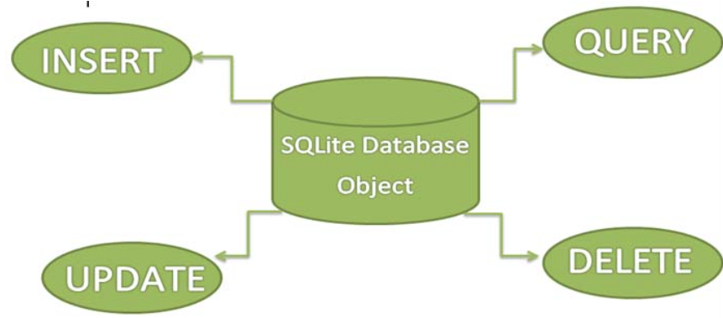

Slide 6
The Basic Advantages of SQLite:
It’s a light weight database
Requires very little memory
An Automatically managed database
The SQLite supports only 3 Datatypes:
Text(like string) – for storing data type store
Integer(like int) – for storing integer primary key
Real(like double)- for storing long values

Slide 7
SQLiteOpenHelper class
The android.database.sqlite.SQLiteOpenHelper class is used for database creation and version management.
For performing any database operation, you have to provide the implementation of onCreate() and onUpgrade() methods of SQLiteOpenHelper class.
There are two constructors of SQLiteOpenHelper class.
Constructor | Description
SQLiteOpenHelper(Context context, String name, SQLiteDatabase.CursorFactory factory, int version) | creates an object for creating, opening and managing the database.
SQLiteOpenHelper(Context context, String name, SQLiteDatabase.CursorFactory factory, int version, DatabaseErrorHandler errorHandler) | creates an object for creating, opening and managing the database. It specifies the error handler.

Slide 8
There are many methods in SQLiteOpenHelper class. Some of them are as follows:
Method | Description
public abstract void onCreate(SQLiteDatabase db) | called only once when database is created for the first time.
public abstract void onUpgrade(SQLiteDatabase db, int oldVersion, int newVersion) | called when database needs to be upgraded.
public synchronized void close () | closes the database object.
public void onDowngrade(SQLiteDatabase db, int oldVersion, int newVersion) | called when database needs to be downgraded.

Slide 9
SQLiteDatabase class
There are many methods in SQLiteDatabase class. Some of them are as follows:
Method | Description
void execSQL(String sql) | executes the sql query not select query.
long insert(String table, String nullColumnHack, ContentValues values) | inserts a record on the database. The table specifies the table name, nullColumnHack doesn't allow completely null values. If second argument is null, android will store null values if values are empty. The third argument specifies the values to be stored.
int update(String table, ContentValues values, String whereClause, String[] whereArgs) | updates a row.
Cursor query(String table, String[] columns, String selection, String[] selectionArgs, String groupBy, String having, String orderBy) | returns a cursor over the resultset.

Slide 10
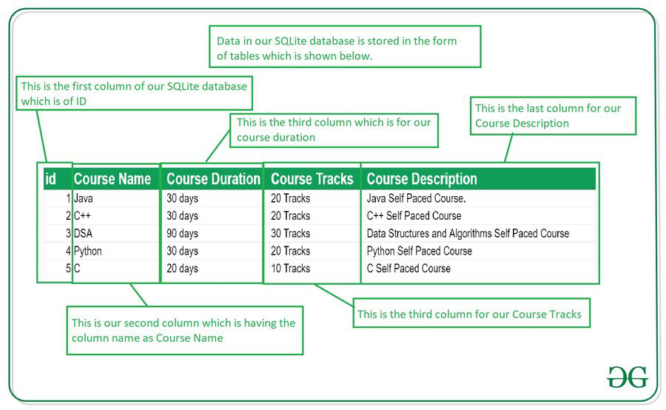
Data is stored in the SQLite database in the form of tables. When we stored this data in our SQLite database it is arranged in the form of tables that are similar to that of an excel sheet. Below is the representation of our SQLite database which we are storing in our SQLite database.

Slide 11
Methods in SQLite Database
Method | Description
getColumnNames() | This method is used to get the Array of column names of our SQLite table.
getCount() | This method will return the number of rows in the cursor.
isClosed() | This method returns a Boolean value when our cursor is closed.
getColumnCount() | This method returns the total number of columns present in our table.
getColumnName(int columnIndex) | This method will return the name of the column when we passed the index of our column in it.
getColumnIndex(String columnName) | This method will return the index of our column from the name of the column.
getPosition() | This method will return the current position of our cursor in our table.

Slide 12
Creating Database and table using SQLite
Create one java class and name it as DatabaseHandler which is subclass of SQLiteOpenHelper.
package com.example.sqlite; import android.content.ContentValues; import android.content.Context; import android.database.sqlite.SQLiteDatabase; import android.database.sqlite.SQLiteOpenHelper; public class DatabaseHandler extends SQLiteOpenHelper { private static final int DATABASE_VERSION = 1; private static final String DATABASE_NAME = "contactsManager"; private static final String TABLE_CONTACTS = "contacts"; private static final String KEY_ID = "id"; private static final String KEY_NAME = "name"; private static final String KEY_PH_NO = "phone_number"; public DatabaseHandler(Context context) { super(context, DATABASE_NAME, null, DATABASE_VERSION); }

Slide 13
// Creating Tables @Override public void onCreate(SQLiteDatabase db) { String CREATE_CONTACTS_TABLE = "CREATE TABLE " + TABLE_CONTACTS + "(" + KEY_ID + " INTEGER PRIMARY KEY," + KEY_NAME + " TEXT," + KEY_PH_NO + " TEXT" + ")"; db.execSQL(CREATE_CONTACTS_TABLE); } // Upgrading database @Override public void onUpgrade(SQLiteDatabase db, int oldVersion, int newVersion) { // Drop older table if existed db.execSQL("DROP TABLE IF EXISTS " + TABLE_CONTACTS); // Create tables again onCreate(db); } }

Slide 14
MainActivity.java
package com.example.sqlite; import androidx.appcompat.app.AppCompatActivity; import android.os.Bundle; import android.util.Log; import java.util.List; public class MainActivity extends AppCompatActivity { @Override protected void onCreate(Bundle savedInstanceState) { super.onCreate(savedInstanceState); setContentView(R.layout.activity_main); DatabaseHandler db = new DatabaseHandler(this);
}
}

Slide 15
Viewing database in DBBrowser
1.Click on DeviceFileExplorer then click on Data folder -> Data Folder ->com.example.sqlite -> Databases -> Database name
2.Right click on the database name and select Save as option.
3.Choose the location where you want to save the file then click ok.
4.Open DBBrowser→File→open database→fetch the file from the saved location→Select the option ALL files→Click ok.
5.Click Browse Data then select the table name the data related to the table will be displayed in the DBBrowser.

Slide 16
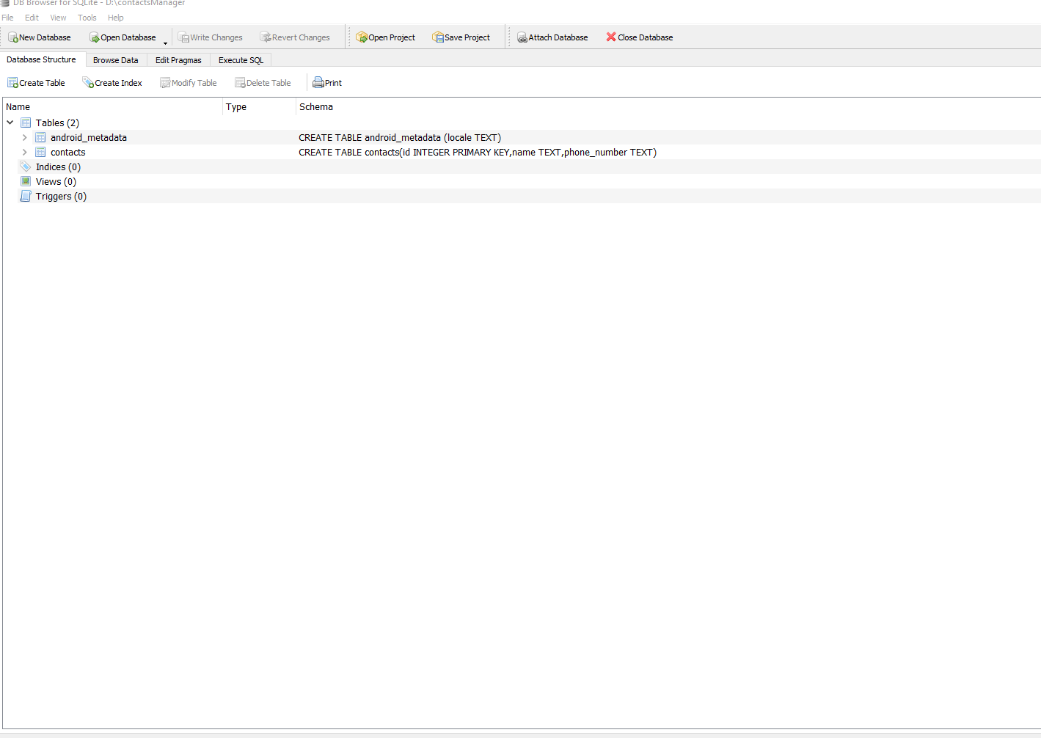

Slide 17
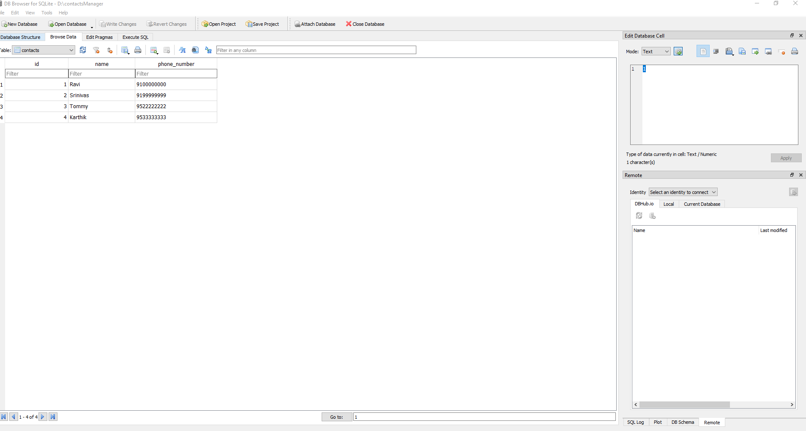

Slide 18
DBHandler.java
package com.example.sqlite_view; import android.annotation.SuppressLint; import android.content.ContentValues; import android.content.Context; import android.database.Cursor; import android.database.sqlite.SQLiteDatabase; import android.database.sqlite.SQLiteOpenHelper; import java.util.ArrayList; import java.util.HashMap; public class DbHandler extends SQLiteOpenHelper { private static final int DB_VERSION = 1; private static final String DB_NAME = "mru_view.db"; public DbHandler(Context context) { super(context, DB_NAME, null, DB_VERSION); } @Override public void onCreate(SQLiteDatabase db) { String CREATE_TABLE = "CREATE TABLE Student (RollNo TEXT PRIMARY KEY, Name TEXT)"; db.execSQL(CREATE_TABLE); } @Override public void onUpgrade(SQLiteDatabase sqLiteDatabase, int i, int i1) { }

Slide 19
boolean SaveStudentDetails(String rollNo, String name) { SQLiteDatabase db = this.getWritableDatabase(); ContentValues cValues = new ContentValues(); cValues.put("RollNo", rollNo); cValues.put("Name", name); long returnValue = db.insert("Student", null, cValues); db.close(); if (returnValue > 0) { return true; } else { return false; } } @SuppressLint("Range") public ArrayList<HashMap<String, String>> GetStudentList() { SQLiteDatabase db = this.getReadableDatabase(); Cursor cursor = db.rawQuery( "select * from Student", null ); ArrayList<HashMap<String, String>> list = new ArrayList<>(); while (cursor.moveToNext()){ HashMap<String,String> department = new HashMap<>(); department.put("RollNo",cursor.getString(cursor.getColumnIndex("RollNo"))); department.put("Name",cursor.getString(cursor.getColumnIndex("Name"))); list.add(department); } return list; } }

Slide 20
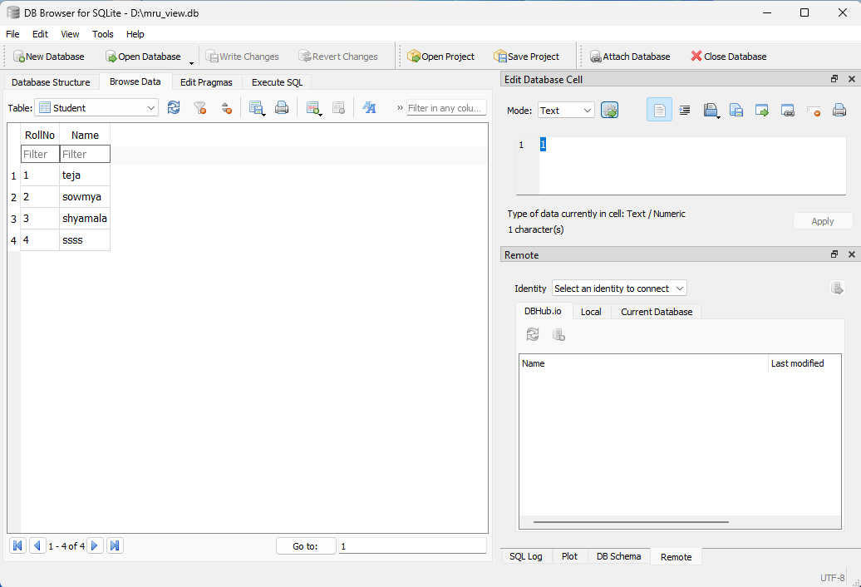

Slide 21
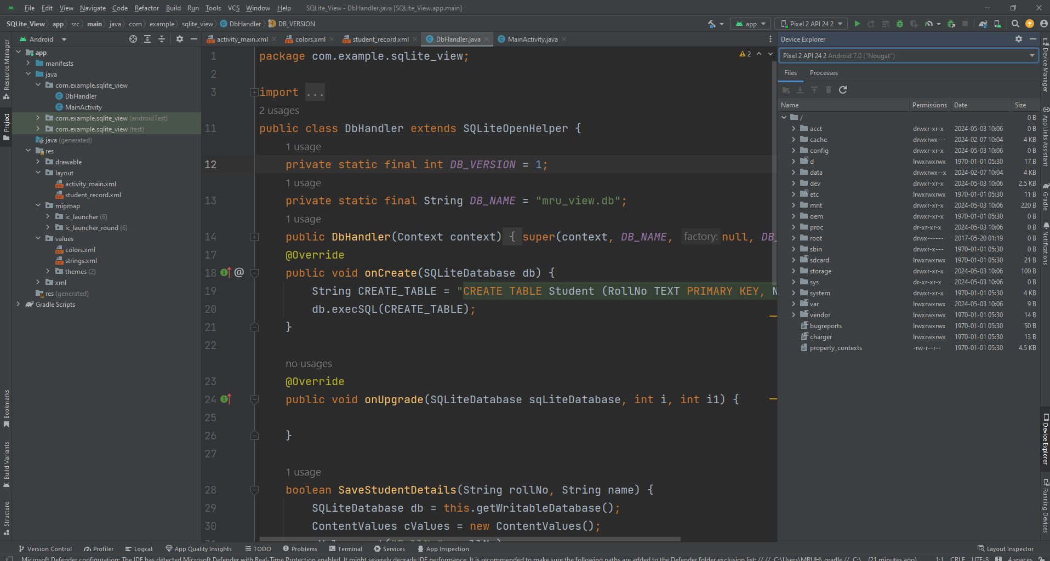

Slide 22
